Slide 1
Math Notebooking
Sarah Smith-3rd grade
Jamie Archambault- 2nd grade

Slide 2
Why notebooking in math?
What’s the purpose?
Students and teachers can:
Persevere in thinking
Critique own thinking
Allow for mistakes
Put visuals to math thinking
Show progress in math and language
Make goals
Increase discourse
Question others
Differentiate & scaffold learning
Clarify thinking
And so much more!!!

Slide 3
CCSS Speaking & Listening
Comprehension and Collaboration:
Engage effectively in a range of collaborative discussions, building on others' ideas and expressing their own clearly.
Come to discussions prepared having read or studied required material; explicitly draw on that preparation and other information known about the topic to explore ideas under discussion.
Follow agreed-upon rules for discussions (e.g., gaining the floor in respectful ways, listening to others with care, speaking one at a time about the topics and texts under discussion).
Ask questions to check understanding of information presented, stay on topic, and link their comments to the remarks of others.
Explain their own ideas and understanding in light of the discussion.
Presentation of Knowledge and Ideas:
Report on a topic, speaking clearly at an understandable pace.
Create visual displays when appropriate to emphasize or enhance certain facts or details.
Speak in complete sentences when appropriate to task and situation in order to provide requested detail or clarification.

Slide 4
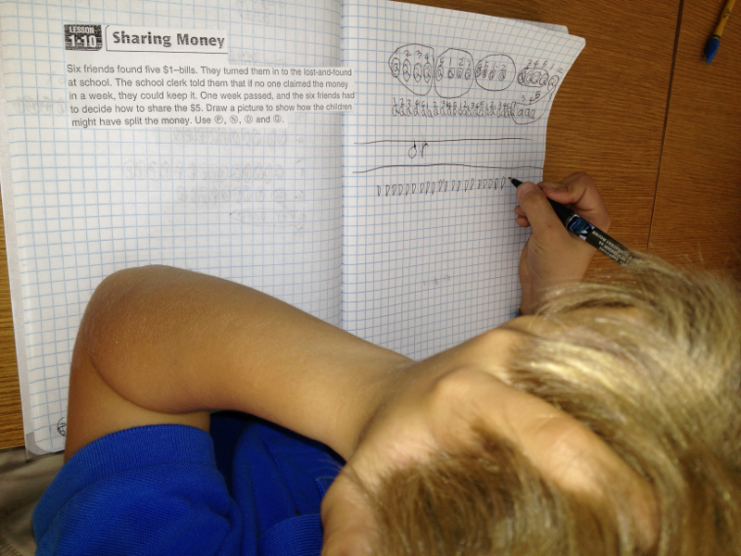
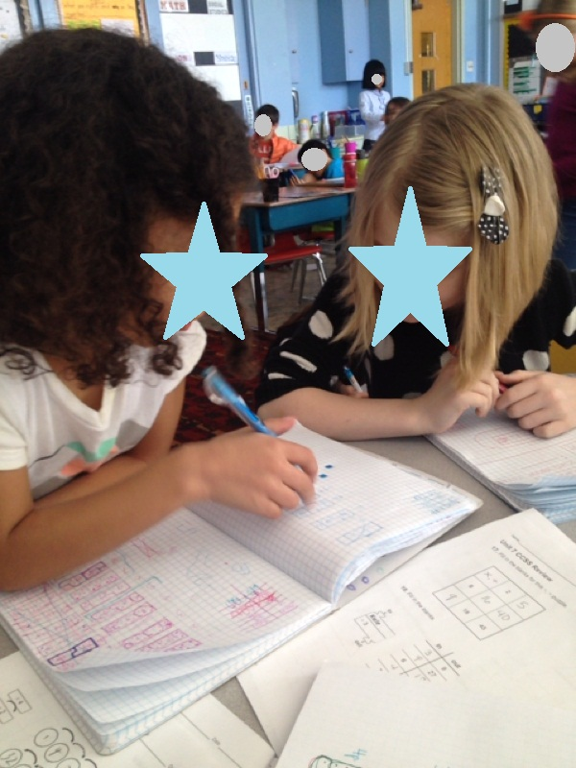
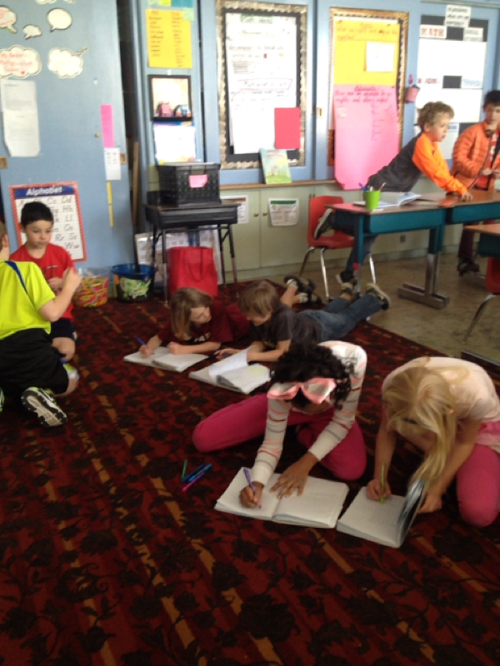
3rd graders notebook in pairs and individually

Slide 5
When and how?
Use notebooks any time you wish students to record MATH THINKING; daily, weekly, whenever needed!
Math Message (EM)
Open Response tasks (EM)
Instructional Tasks (I-tasks)
Part 1 of lesson
Performance Based Tasks (PBT or multiple solution tasks)
Math Work Stations (Debbie Diller or Daily 3)

Slide 6
Materials We Like to Use:
Grid paper composition notebook (King Soopers, Target, Office Max, etc)
Tape
Pens!!!
Tabs (Sticky notes, ribbon bookmark, Post It tabs)
Scissors
Colors or collage materials (to decorate☺)

Slide 7
Resources for Implementation:
http://dpsmathteachersrock.weebly.com/
NCTM Illuminations
Everyday Math Assessment Book: Open Response Tasks

Slide 8
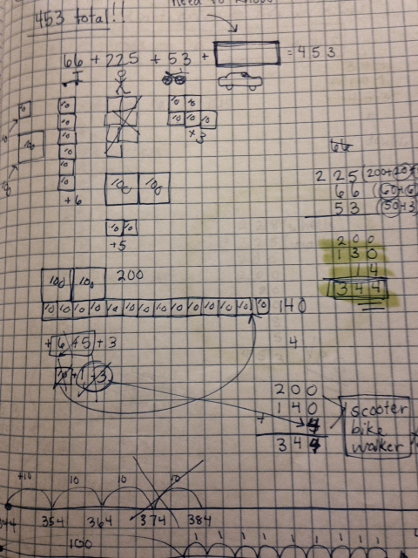
Two Key Ideas (Sarah and Jamie live by.)
1. Math Notebooks are a SAFE place to communicate math thinking: NEVER grade or evaluate. Ask students how they would like feedback.
2. ALWAYS model your notebook with students.

Slide 9
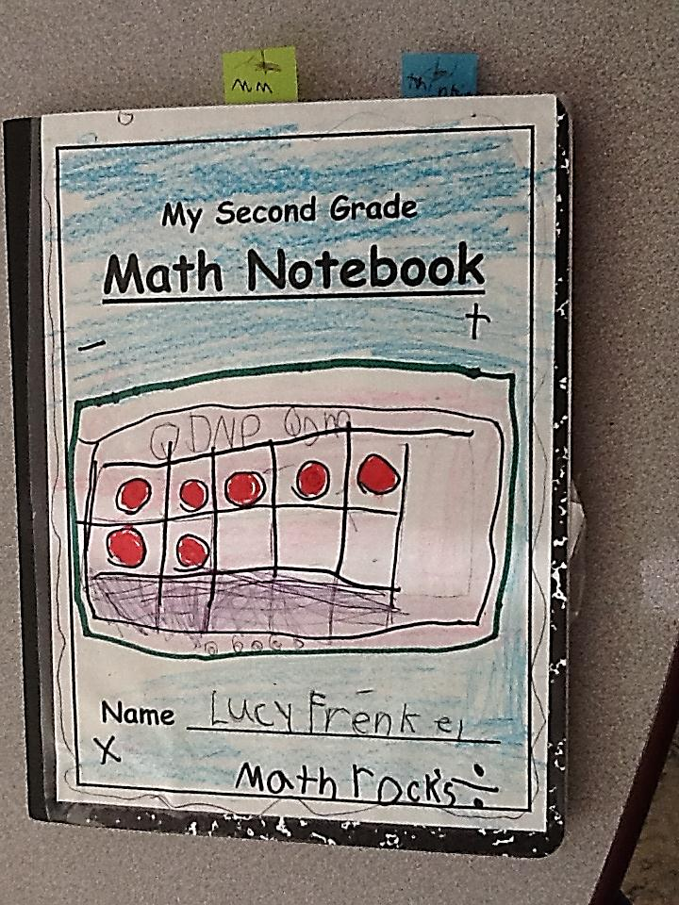
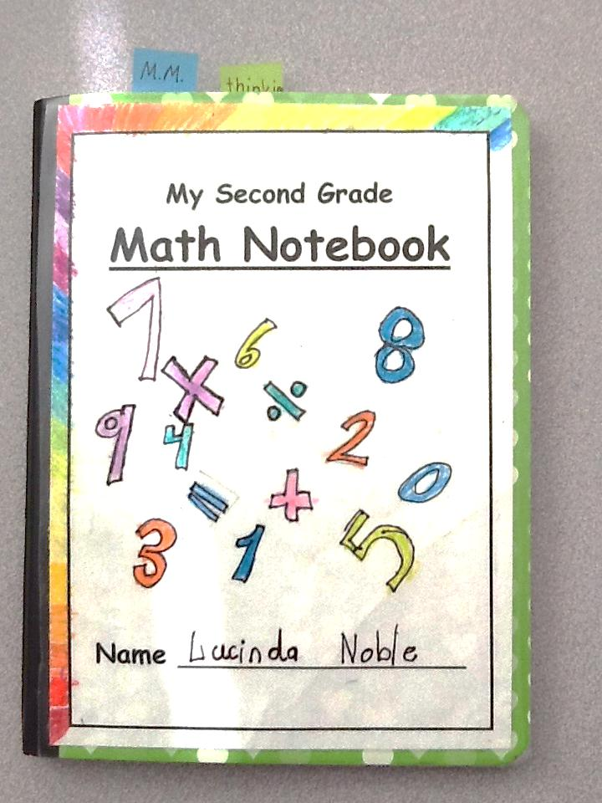
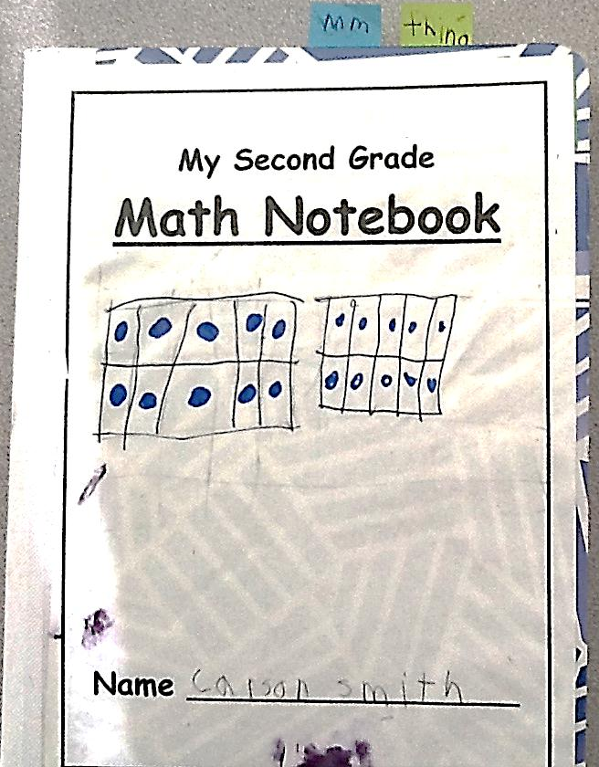
2nd graders are ready to show their thinking!

Slide 10
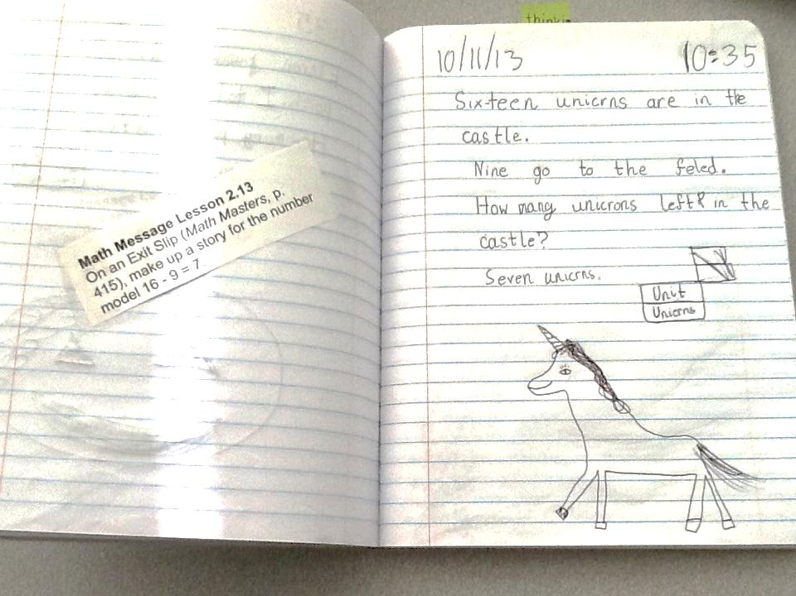

Slide 11
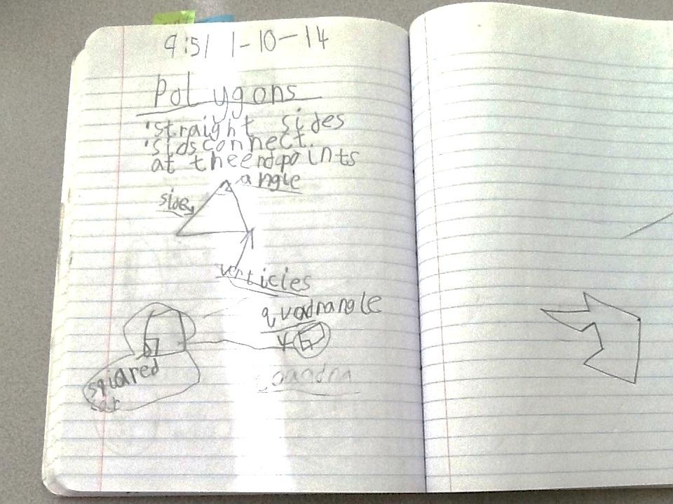

Slide 12
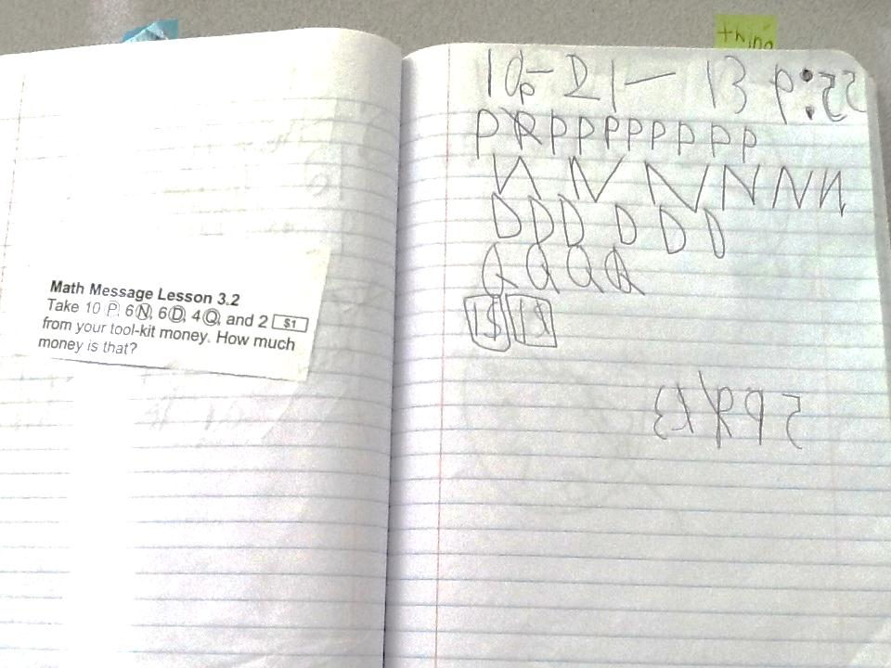

Slide 13
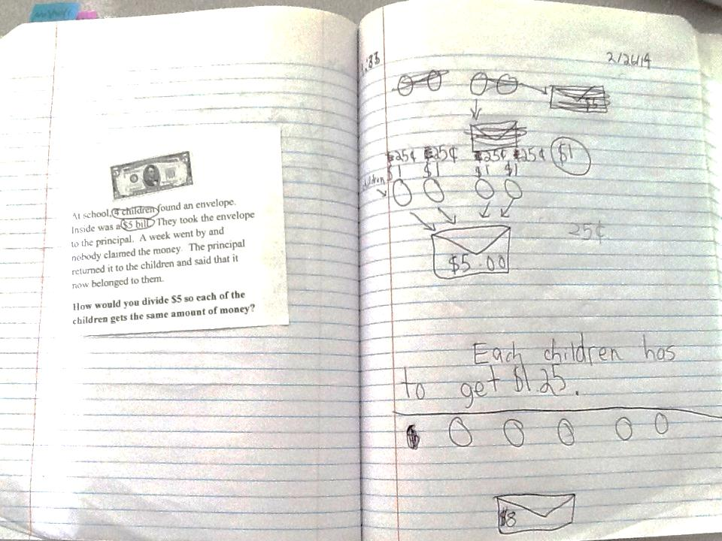

Slide 14
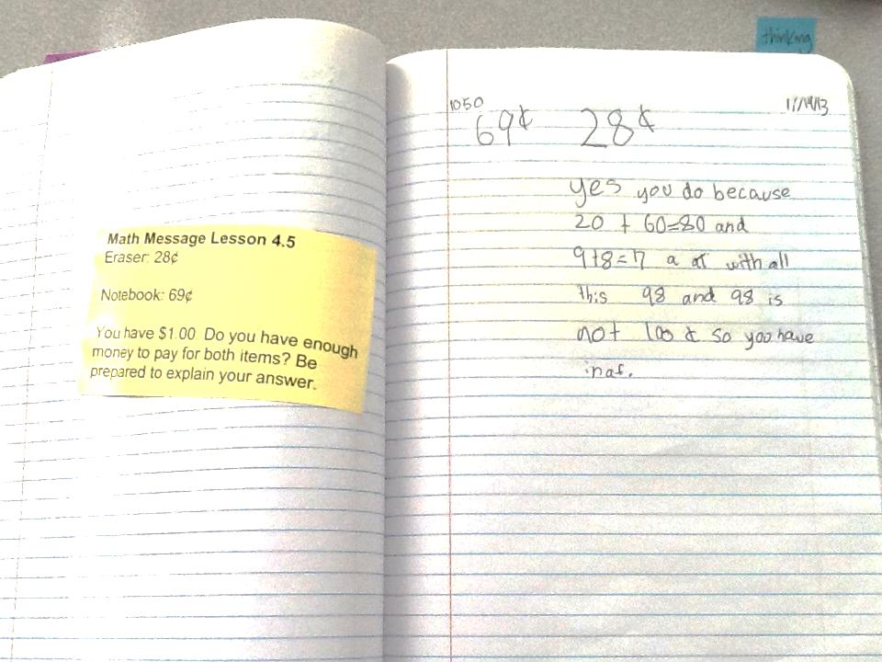

Slide 16
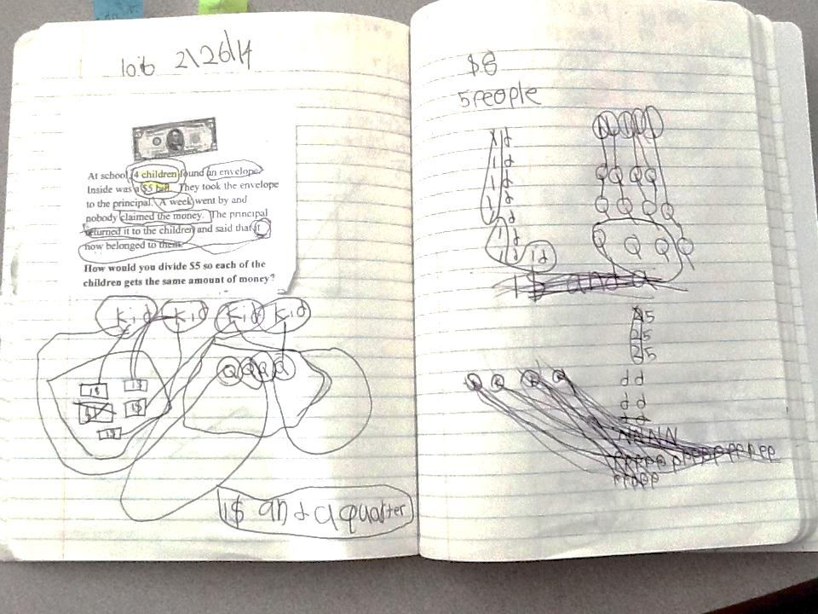

Slide 17
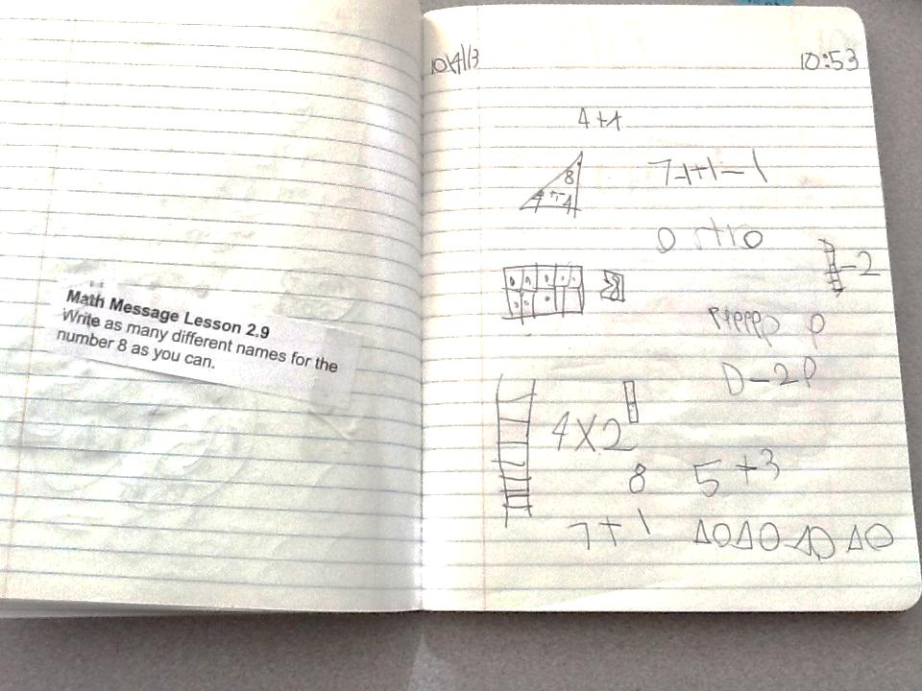

Slide 18
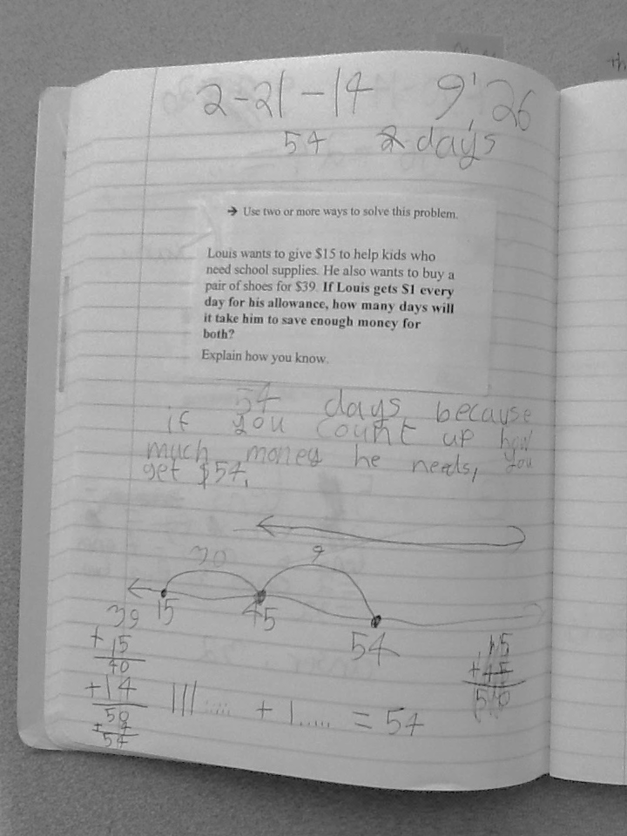

Slide 19
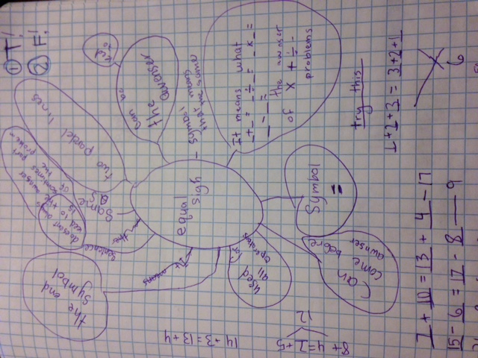

Slide 20
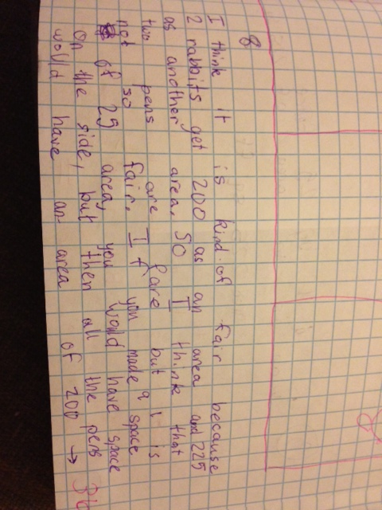

Slide 21
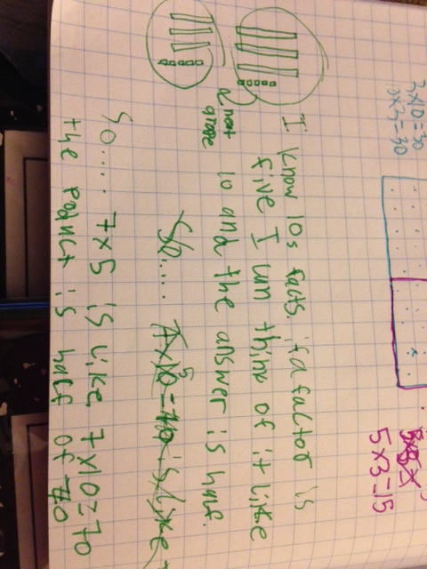

Slide 22
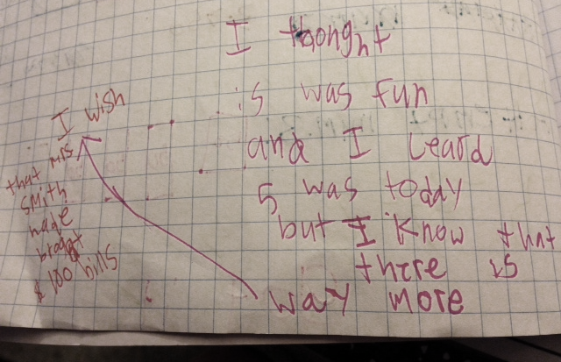
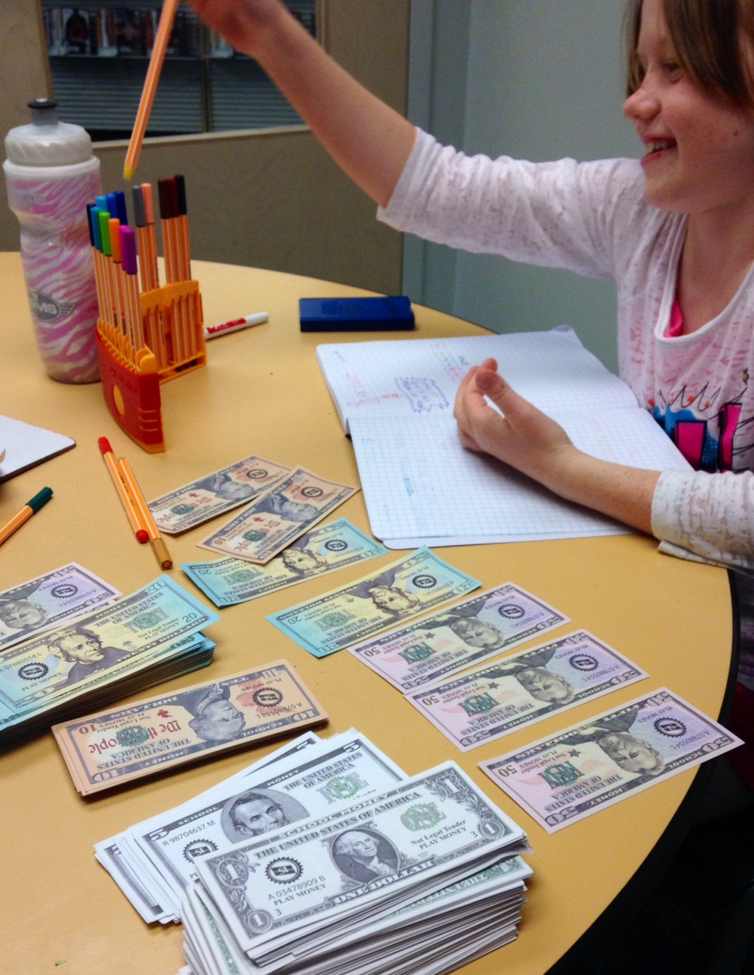
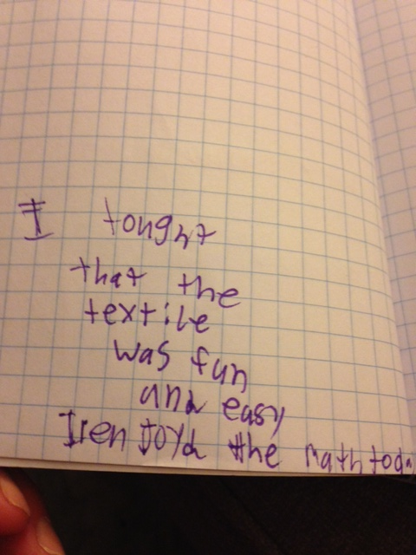
Building CONFIDENCE!

